Slide 1

PCET’s Pimpri Chinchwad College of Engineering
SECURING CYBER PHYSICAL SPACES FROM IRIS PRESENTATION ATTACKS WITH ENHANCE FEATURES USING MACHINE LEARING AND DEEP LEARNING
Disha Magar | 120B1B302
Yash Waghmare | 120B1B298
Lomesh Wagh | 120B1B297
Bhumika Patil | 120B1B282
Guide: Prof Dr. Sudeep D. Thepade
Department of Computer Engineering

Slide 2
CONTENTS
Introduction
Problem Definition
Motivation
Objective
Literature Review
Proposed System
i. Project Plan
ii. Mathematical Model
iii. System Architecture
iv. Algorithmic Details
v. H/W and S/W Specification
7. Functionality
8. Results
9. Application
10. Conclusion and future work
11. Paper publication details
12. Awards Received
13. References

Slide 3
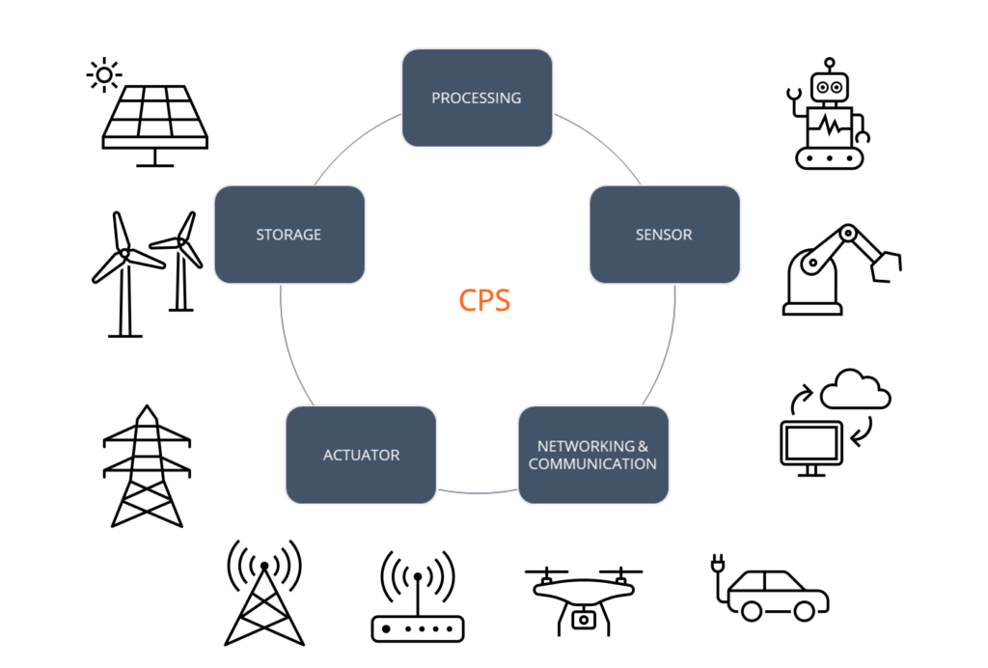
INTRODUCTION
Cyber-Physical Spaces
Cyber-physical spaces (CPS) are networks of internet-connected systems that link computing, networking, and physical processes. CPS finds use in various areas like smart homes, healthcare, and online shopping.

Slide 4
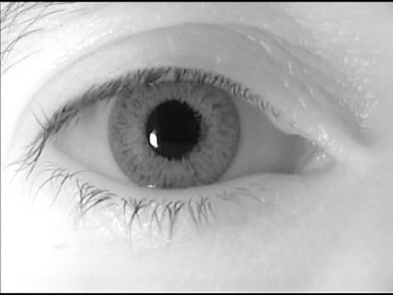
INTRODUCTION
Iris Presentation attacks
In an iris presentation attack, an attacker tries to fool the system by presenting a fake iris instead of a real one
Various Iris presentation attacks to spoof the system.
Transparent lenses attacks
Printed image attacks
Colored iris image attacks, etc.

Slide 5

MOTIVATION
Addressing the primary apprehensions surrounding security within Cyber-Physical Spaces.
Biometric Security Systems are incorporated in CPS, which utilize unique characteristics for identification.
Primary concerns arising from the utilization of biometric systems in CPS.
Instances of presentation attacks, including those targeting iris, fingerprint, and face detection systems, can occur within the CPS environment.

Slide 6
OBJECTIVES
To address the distinction between real and fake biometric traits for security in CPS.
To enhance security through the integration of biometric systems, with a focus on liveness detection.
To strengthen existing systems against spoofing attacks.
To integrate liveness detection seamlessly into current systems for improved robustness without major changes.

Slide 7
LITERATURE REVIEW
REFERENCES | TECHNIQUE | RESULTS | DATASETS
[1] | Invariant feature-set using Friedman test and Lehmar code encoding. | IIITD-CSD-ACER:1.45%, EER:1.36% IIITD-Iris Spoofing- ACER: 1.61%, EER: 0.94% Clarkson- ACER:2.10%, EER:0.79% | IIITD-Contact Lens, IIITD-Iris Spoofing, Clarkson-2015, Warsaw-2015
[2] | Fragmental Energy of Haar Transformed Iris Images Using Ensemble of Machine Learning Classifiers | Clarkson2013- ACER:2.63% Clarkson2015- ACER:3.2% IIITD CSD- APCER:2.59%, BPCER:ACER:2.29% | Clarkson LivDet2013, Clarkson LivDet2015, IIITD CSD
[3] | Hyperparameter tuning of the CASIA algorithm. | Threshold: 50 APCER: 4.18%, BPCER: 0% | Clarkson, Warsaw, IIITD-VWU, Notre Dame

Slide 8
LITERATURE REVIEW
REFERENCES | TECHNIQUE | RESULTS | DATASETS
[4] | Cascade of Dedicated Deep Learning Networks | BPCER: 0.16%, EER: 0.33% | LivDet-Iris 2020
[5] | Iris vitality detection network (IVIDNet) | ACER: 0.60% | Notre Dame 2017, Notre Dame cosmetic lenses dataset
[6] | Deep Convolution Networks (Inception V3, Resnet50, Densenet121, VGG-16, EfficientNetB7) | Identification accuracy: 99.97% | LivDet-Iris 2015, IIITD contact, ND Iris3D 2020

Slide 9
PROPOSED SYSTEM
i. Project Plan
Fusion of texture-based and auto-extracted features
Analysis of multiple classifiers and ensembles
Final Outcome
Examining auto-extracted features utilizing 4 CNN models.
6
5
Exploring Explicit(texture-based) features
4
Exploring the Auto-extracted features
3
2
1

Slide 10
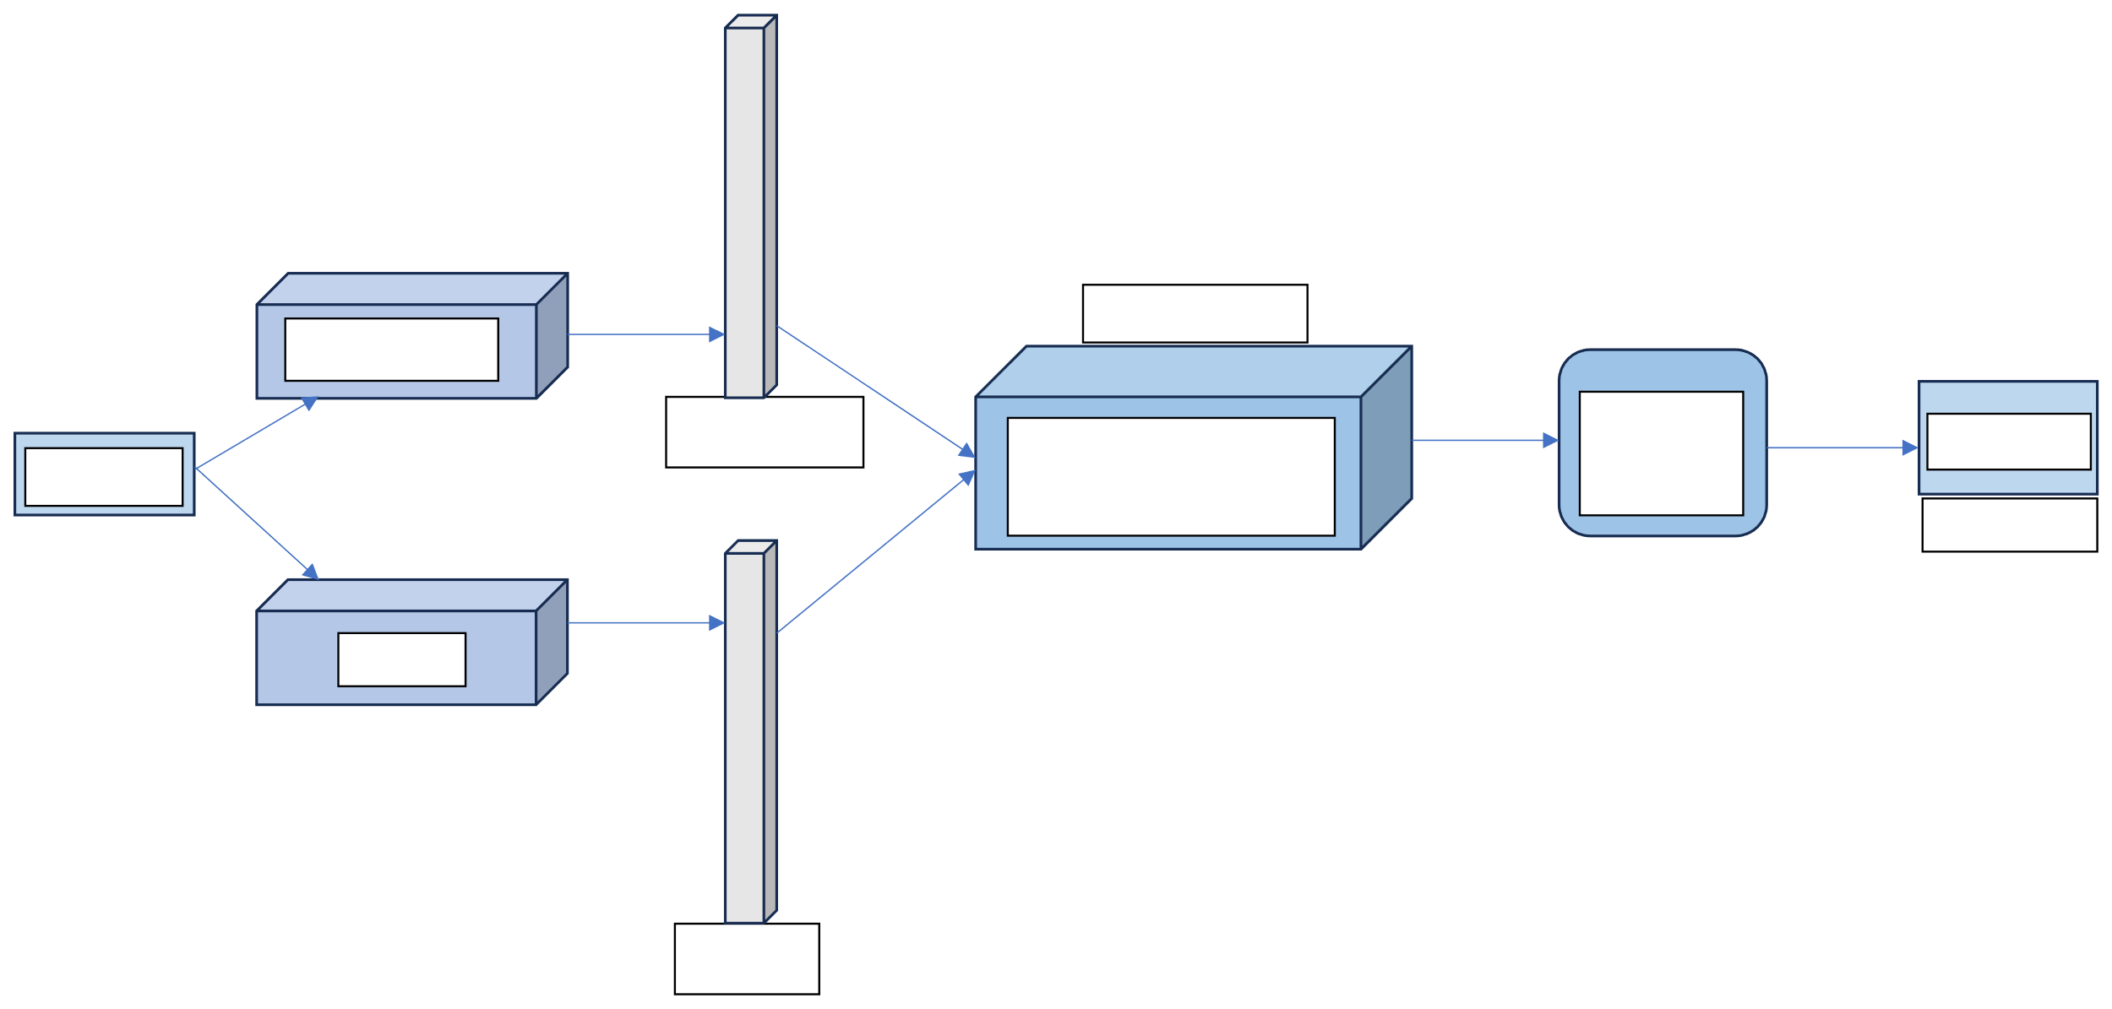
ii. Mathematical Model
Feature fusion
Conv Network
𝑓
(𝑥)
Classifier CLS(𝑓(𝑥))
Output Y
Live/Spoof
𝐷𝑒𝑛𝑠𝑒𝑛𝑒𝑡
𝑓
𝑓(𝑥) = [
𝑓
𝐷𝑒𝑛𝑠𝑒𝑛𝑒𝑡 (𝐺𝐿𝐶𝑀)
(𝑥)
]
(𝑥)
Iris image
GLCM
𝑓
𝐺𝐿𝐶𝑀
(𝑥)

Slide 11



iii. System Architecture
Haralick texture features extraction using glcm
Iris Liveness Detection (real or fake)
Biometric security system for iris recognition
Harmonization of extracted features
Iris image
Iris features auto extraction
Access to CPS
Access Denied

Slide 12
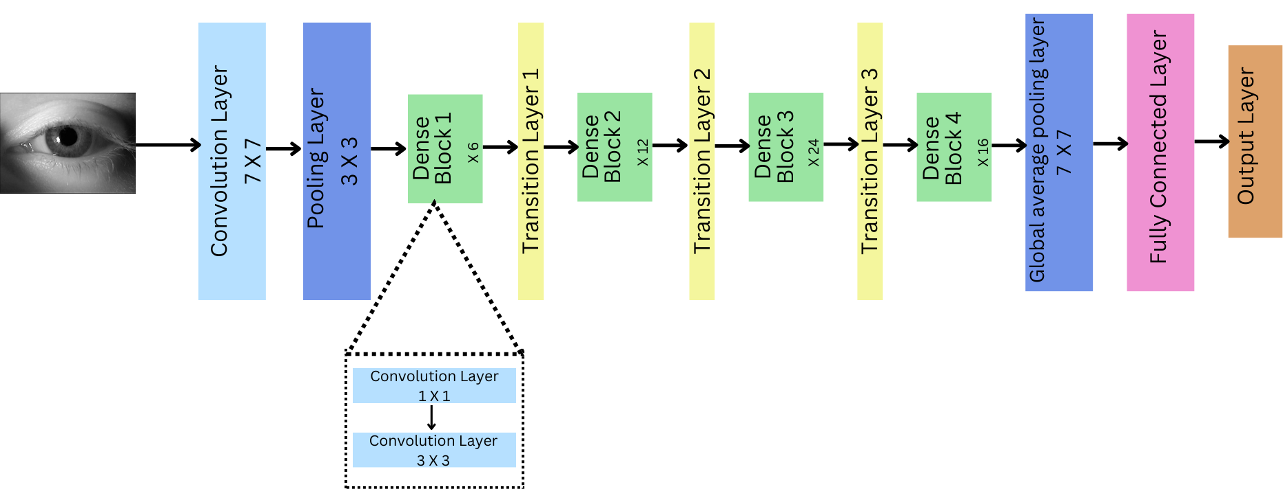
iv. Algorithmic details
Feature Extraction from CNN:
Unfreezing the last block of the CNN architecture allows for fine-tuning the model on the dataset, capturing intricate details specific to iris images.
Features are extracted from the last flatten layer of the CNN, representing high-level abstract features learned by the model.
DenseNet121
Unfreezed Block

Slide 13

2. Feature Extraction using GLCM:
GLCM (Gray-Level Co-occurrence Matrix) features such as dissimilarity, correlation, energy, and ASM are computed for each iris image.
GLCM captures texture and structural information present in the images, providing complementary features to those extracted by CNN.
Right neighbor GLCM
Normalized GLCM P (i,j)
Gray level image
Neighbor pixel value (j)
Neighbor pixel value (j)
1 | 1 | 2 | 1
2 | 1 | 1 | 1
3 | 2 | 3 | 1
3 | 2 | 1 | 2
1 | 2 | 3
1 | 2 | 3
1
2
3
3 | 2 | 0
3 | 0 | 1
1 | 2 | 2
1
2
3
0.25 | 0.17 | 0
0.25 | 0 | 0.08
0.08 | 0.17 | 0
Reference pixel value (i)
Reference pixel value (i)

Slide 14
3. Feature Fusion:
The features extracted from both CNN and GLCM are combined to form a unified feature representation for each iris image.
Fusion techniques such as concatenation or weighted averaging may be employed to merge the two sets of features effectively.
4. Developing new ensemble of machines learning classifiers:
The combined feature set have been classified as live/ spoofed with the help of ensemble of best classifiers (Decided after comparative analysis of multiple classifiers)
Machine learning or pattern recognition techniques are applied to this feature set to classify iris images into live or spoofed categories.
5. Evaluation and Validation:
The performance of the fusion algorithm is evaluated using appropriate metrics such as accuracy, APCER, BPCER, ACER
Cross-validation or separate validation datasets are used to ensure the robustness and generalization of the algorithm across different datasets and scenarios.

Slide 15
v. H/W and S/W specifications
Hardware Specifications
Software Specifications
CPU/GPU
Memory (RAM)
Storage
Iris Scanner
Python
VS Code/ Jupyter Notebooks
Deep Learning Frameworks
Machine Learning Libraries
Weka software
Statistical Libraries (NumPy)
Image processing libraries

Slide 16
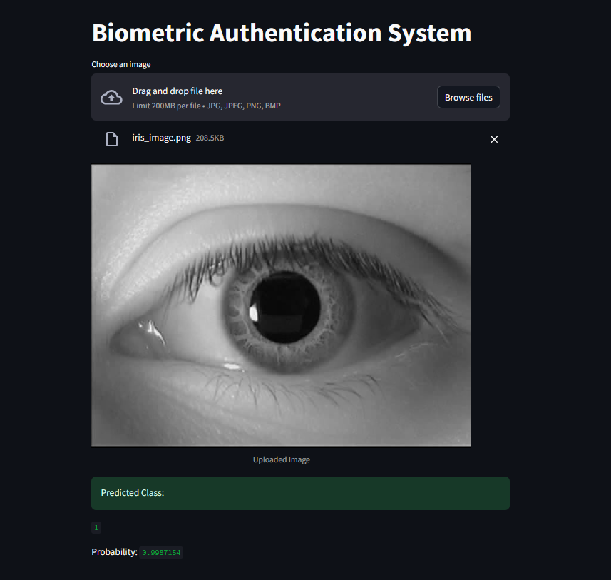
FUNCTIONALITY

Slide 17
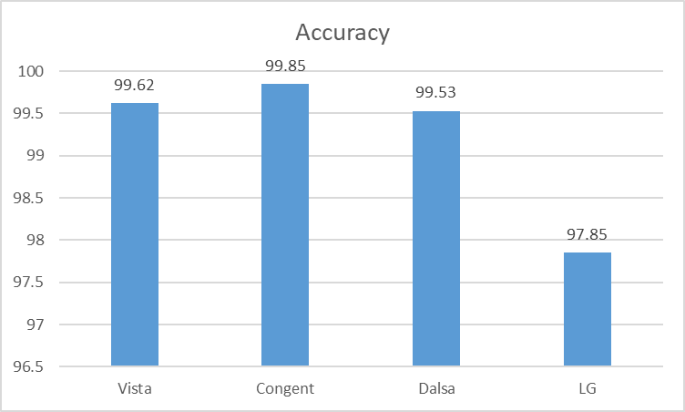
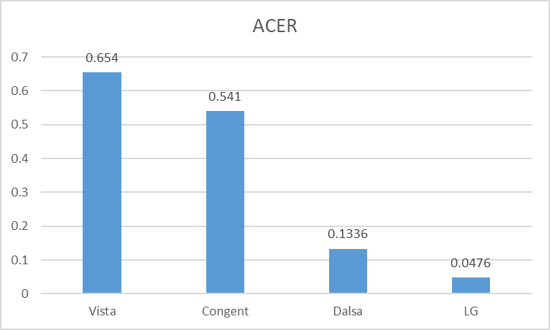
RESULTS
Results by fusion of Densenet121 and GLCM
Best Results have been given by newly introduced ensemble IBK+Logistic+SMO

Slide 18
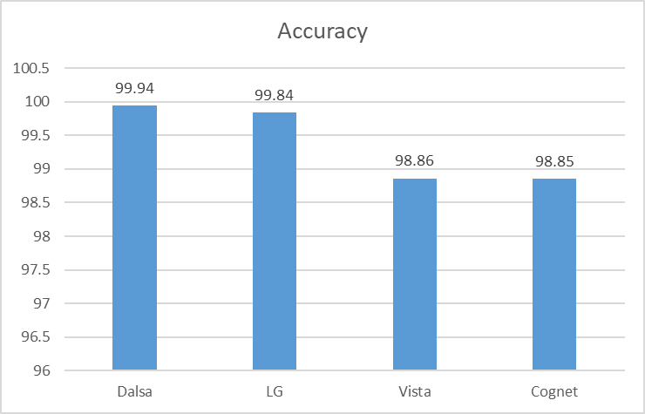
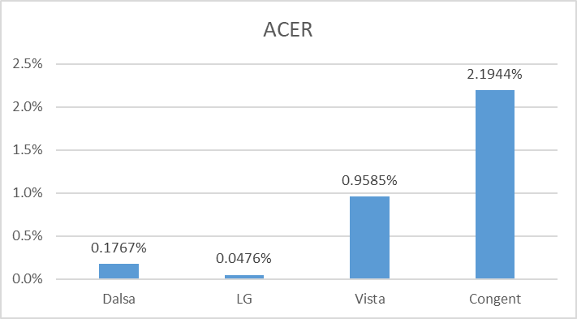
RESULTS
Results by fusion of ResNet50 and GLCM

Slide 19
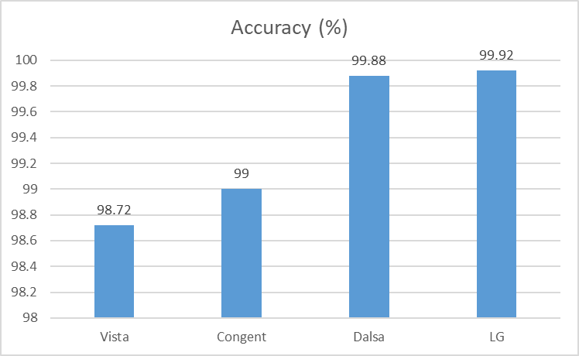
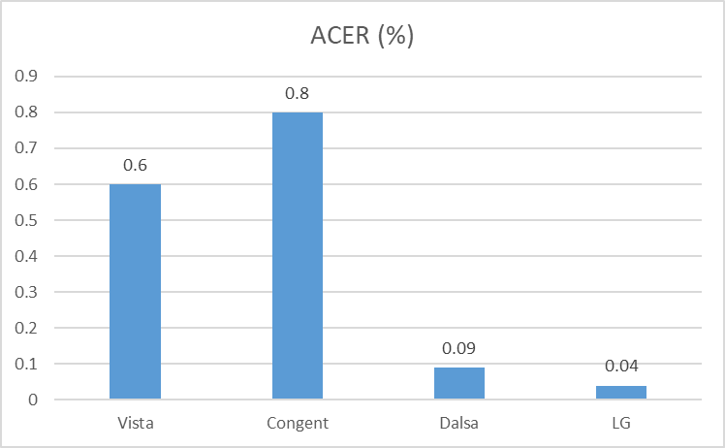
RESULTS
Results by fusion of EfficientNetB0 and GLCM

Slide 20
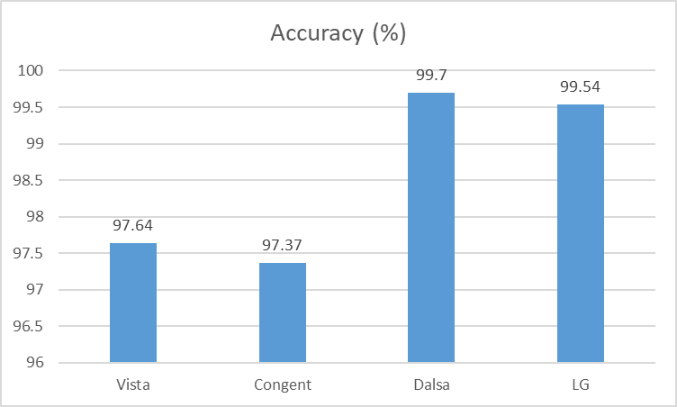
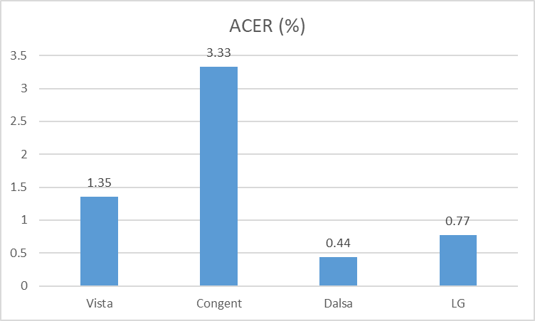
RESULTS
Results by fusion of InceptionV3 and GLCM

Slide 21
APPLICATIONS
Iris presentation attack detection plays a vital role in safeguarding critical infrastructure systems.
Financial Sector Security: By accurately verifying the identity of individuals, these systems prevent fraudulent activities, unauthorized access to accounts, and identity theft, thereby safeguarding the integrity of financial transactions and protecting customer assets.
Government and Defense Applications: These systems enable secure access control to government buildings, military installations, and border crossings, ensuring that only authorized personnel are granted entry.
Healthcare and biometrics: Iris presentation attack detection plays a crucial role in patient identification, access control to medical records, and ensuring the integrity and confidentiality of healthcare data.
Smart Cities and IOT Integration: These systems enable secure access to smart buildings, transportation systems, and public services, protecting against unauthorized access, tampering, and malicious attacks.

Slide 22
CONCLUSION
The integration of ensemble techniques and dynamic thresholding mechanisms has showcased promising results.
Highest accuracy gained is ~99.9% and lowest ACER obtained is around 0.047%.
By harnessing the power of machine learning and deep learning algorithms, we have been able to discern intricate patterns and variations within iris images, thus improving our ability to distinguish between genuine and fraudulent presentations.
Immense potential in fortifying CPS environments against sophisticated attacks and unauthorized access attempts.

Slide 23
FUTURE WORK
Utilization of Generative Adversarial Networks (GANs) for generating synthetic presentation attack images represents a novel direction for future research.
Imperative for future research endeavors to prioritize three key areas: leveraging cross-data validation techniques, exploring the fusion of multiple methodologies, and harnessing GAN generated images for iris presentation attack detection.

Slide 24
PAPER PUBLICATION DETAILS
Demonstration of Developed
Iris Liveness Detection for Biometric Access Control System in Smart Home Security using Deep Convolutional Neural Network.
Journal: IJOSI (Scopus)
Status: Submitted
Advancing Iris Liveness Detection in Cyber-Physical Environments: A Fusion Strategy Integrating GLCM and DenseNet121 Features
Journal: ECJSE (Scopus)
Status: Submitted

Slide 25
AWARDS RECEIVED
Demonstration of Developed
Anantya BTech Project Competition
1st Runner up

Slide 26
REFERENCES
Demonstration of Developed
[1] Kaur, B. Fingerprint and Iris liveness detection using invariant feature-set. Multimed Tools Appl (2024). https://doi.org/10.1007/s11042-023-17854-w
[2] Khade, S., Gite, S., Thepade, S. D., Pradhan, B., & Alamri, A. (2023). Iris Liveness Detection Using Fragmental Energy of Haar Transformed Iris Images Using Ensemble of Machine Learning Classifiers. CMES-COMPUTER MODELING IN ENGINEERING & SCIENCES, 136(1), 323-345.
[3] Kimura, G. Y., Lucio, D. R., Britto Jr, A. S., & Menotti, D. (2020). CNN hyperparameter tuning applied to iris liveness detection. arXiv preprint arXiv:2003.00833.
[4]J. E. Tapia, S. Gonzalez and C. Busch, "Iris Liveness Detection Using a Cascade of Dedicated Deep Learning Networks," in IEEE Transactions on Information Forensics and Security, vol. 17, pp. 42-52, 2022, doi: 10.1109/TIFS.2021.3132582.
[5] Verma, P., Selwal, A. & Sharma, D. IVIDNet: Intelligent iris vitality detection via weighted prediction score level fusion. Multimed Tools Appl 82, 45959–45981 (2023). https://doi.org/10.1007/s11042-023-15421-x
[6] Khade, S., Ahirrao, S., Phansalkar, S., Kotecha, K., Gite, S., & Thepade, S. D. (2021). Iris liveness detection for biometric authentication: A systematic literature review and future directions. Inventions, 6(4), 65. https://doi.org/10.3390/inventions6040065

Slide 27
THANK YOU!

